Slide 1
DATA STRUCTURES
Binary Trees, BST & Traversals
Building a BST from my own dataset and tracing three traversals
50
C++ Programming | Lab 01
Arya Desai
30
70
BST

Slide 2
01 • IDEA
02
What is a binary tree?
A binary tree is a structure where each node can have at most two children.
Those children are called the left child and right child.
root
Key terms
50
Node • Root • Parent • Child • Leaf
Left subtree • Right subtree
30
70
A leaf is a node with no children.
C++ Programming • Lab 01
Arya Desai

Slide 3
02 • BST
03
What makes a binary search tree different?
A BST adds an ordering rule to a binary tree.
For every node:
In my code
Smaller values → left
Larger values → right
if (value < node->data)
go left
else if (value > node->data)
go right
else
ignore duplicate
Duplicate values are not inserted in my implementation.
This is the rule that builds the tree.
C++ Programming • Lab 01
Arya Desai

Slide 4
03 • MY DATASET
04
The values I used
I used 15 integers, including two duplicates.
50 30 70 20 40 60 80 30 70 10 35 65 90 55 75
Duplicates found
Why ignore them?
30 → ignored
70 → ignored
The BST rule in my program only inserts values that are smaller or larger than the current node.
C++ Programming • Lab 01
Arya Desai

Slide 5
04 • BUILD
05
How the BST was built
The remaining values were inserted in their original order.
50 → 30 → 70 → 20 → 40 → 60 → 80 → 10 → 35 → 65 → 90 → 55 → 75
Each new value moves left or right until it finds an empty position.
Each new value moves left or right until it finds an empty position.
50
30
70
Completed BST
C++ Programming • Lab 01
Arya Desai
20
40
60
80
35
55
65
75
90

Slide 6
05 • TREE
06
My completed BST
root
50
30
70
20
40
60
80
35
55
65
75
90
left subtree
right subtree
Leaves: 10, 35, 55, 65, 75, 90
C++ Programming • Lab 01
Arya Desai

Slide 7
06 • STRUCTURE
07
Root, leaves, subtrees, predecessor & successor
For my BST, the root is 50.
50
30
70
20
40
60
80
35
55
65
75
90
Left subtree starts at 30
Predecessor of 50 = 40
Successor of 50 = 55
C++ Programming • Lab 01
Arya Desai

Slide 8
07 • TRAVERSALS
08
Three ways to visit the tree
INORDER
LEFT → ROOT → RIGHT
10 20 30 35 40 50 55 60 65 70 75 80 90
PREORDER
ROOT → LEFT → RIGHT
50 30 20 10 40 35 70 60 55 65 80 75 90
POSTORDER
LEFT → RIGHT → ROOT
10 20 35 40 30 55 65 60 75 90 80 70 50
C++ Programming • Lab 01
Arya Desai

Slide 9
08 • INORDER
09
Why BST inorder is sorted
Inorder visits the left subtree, then the node, then the right subtree.
Because a BST stores smaller values on the left and larger values on the right, the result comes out in ascending order.
10 20 30 35 40 50 55 60 65 70 75 80 90
This is exactly the inorder output from my program.
C++ Programming • Lab 01
Arya Desai

Slide 10
09 • IMPLEMENTATION
10
How I handled insertion & duplicates
My approach
if (node == nullptr)
return new Node(value);
if (value < node->data)
node->left = insert(node->left, value);
else if (value > node->data)
node->right = insert(node->right, value);
else
cout << "Duplicate " << value << " ignored.";
• Create a Node with data, left, and right.
• Start with an empty root.
• Compare each value with the current node.
• Go left for smaller values and right for larger values.
• Ignore equal values as duplicates.
C++ Programming • Lab 01
Arya Desai

Slide 11
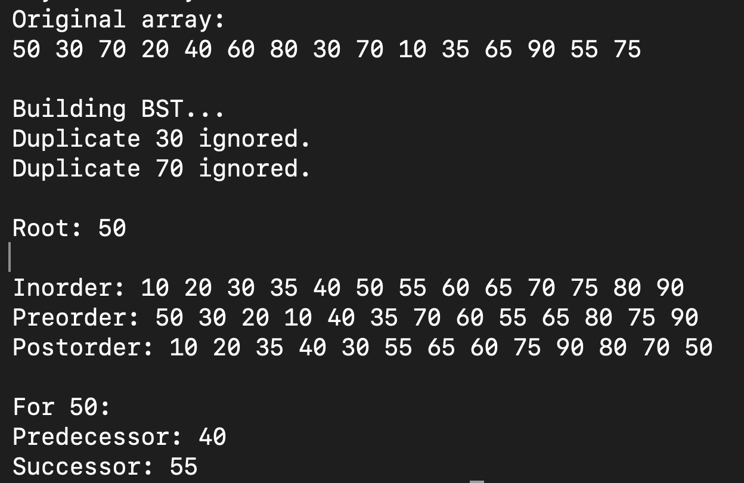
10 • RUN
11
My actual program output
This is the output from the BST program I ran in Terminal.
It shows the original array, rejected duplicates, root, traversals, predecessor, and successor.
C++ Programming • Lab 01
Arya Desai

Slide 12
11 • USES
12
Where trees and BSTs are useful
File systems
Organization charts
A tree represents folders and files in a hierarchy.
A tree can show relationships between managers and employees.
Searching ordered data
Sorted data
A BST organizes values so comparisons guide the search left or right.
A BST can maintain values in an ordered structure; inorder traversal gives sorted output.
C++ Programming • Lab 01
Arya Desai

Slide 13
12 • REFLECTION
13
What I learned
Building the tree helped me understand how the BST rule controls where every value goes.
The most useful part for me was seeing the same tree produce three different traversal orders. The inorder result also made it clear why a BST can produce sorted values.
DUPLICATES
30 and 70 were detected and ignored.
TRAVERSALS
The visit order changes depending on where the root is visited.
BST
Smaller values move left; larger values move right.
C++ Programming • Lab 01
Arya Desai

Slide 14
13 • SOURCES
14
References
1
Virginia Tech OpenDSA — Binary Search Trees
https://opendsa-server.cs.vt.edu/ODSA/Books/CS3S26slides/html/BST.html
2
Virginia Tech OpenDSA — Binary Trees
https://opendsa-server.cs.vt.edu/ODSA/Books/CS3S26slides/html/BinaryTree.html
3
cppreference — C++ pointers
https://en.cppreference.com/w/cpp/language/pointer
The dataset, diagrams, code, and Terminal testing shown here are my own work.
C++ Programming • Lab 01
Arya Desai

